Slide 1

: Project Title: CKD PACKAGING VISION POKAYOKE TRACEABILITY SYSTEM
Project Developed & Design by:
KAPSE SONS ROBOTICS & AUTOMATION

Slide 2
CONTENT
PROBLEM STATEMENT & OBJECTIVE
SCOPE OF WORK
CURRENT SYSTEM
NEW SYSTEM
PROCESS FLOW
ROBOT & VISION SYSTEM
TRACEABILITY- BARCODE, SCANNER, BIOMETRIC

Slide 3
INTRODUCTION
This Project focuses on CKD vision based part inspection with box packing & traceability system.

Slide 4
Problem statement &objectives
Problem statement : To check all BOPs of finished parts & packed it in box according to matrix set in system & traced it.
Objectives: To achieve the 100% repeatability in CKD inspection & traceability system.

Slide 5
Scope of work
ANALYSIS
DESIGN
SIMULATION USED
IMPLEMENTATION PLAN
Analysis of Past history of the current assembly line in CKD Operation.
We design new robotic vision based inspection system with traceability.
Took a trials on AI based vision system with robot arm.
During design the project we planned how to execute & implement it efficiently.

Slide 6
Current system & process
The current CKD pokayoke system has 3 conveyors. Out of which 1 is ment for empty box & 2 for vision based part inspections. As current system has stationary vision system, there are limitations of field of view. So we can not inspect complete part.
For each part there is barcode printer & scanner to apply traceability.
There is 1 weighing scale with conveyor which help us to check complete part filled box weight check with standard weight which stored in system & accordingly will get OK/NG result of box.

Slide 7
NEW system & process
The new system has 3 conveyors out of which 1 is ment for box & other 2 for part inspection.
But here we are eliminating all old vision system problem.
We are implementing robotic vision based system. The robotic will move in such way that the camera will get all necessary images as required for inspections.
Also we are using 2 weighing scale for box. Initially we are making box weight to null so that there is no environmental effect of box.
Also we have biometric system, barcode generator & scanners to implement flawless traceability.

Slide 8
LH VISION CONVEYOR WITH ROBOT
WORK FLOW CHART
Robotic vision system
LH PART IP
LH PART BARCODE TBL
EMPTY BOX WEIGHING TABLE
BOX CONVEYOR
FINISH BOX WEIGHING CONVEYOR
RH VISION CONVEYOR WITH ROBOT
RH PART IP
RH PART BARCODE TBL
Robotic vision system

Slide 9
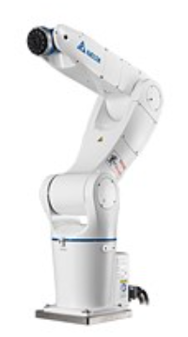
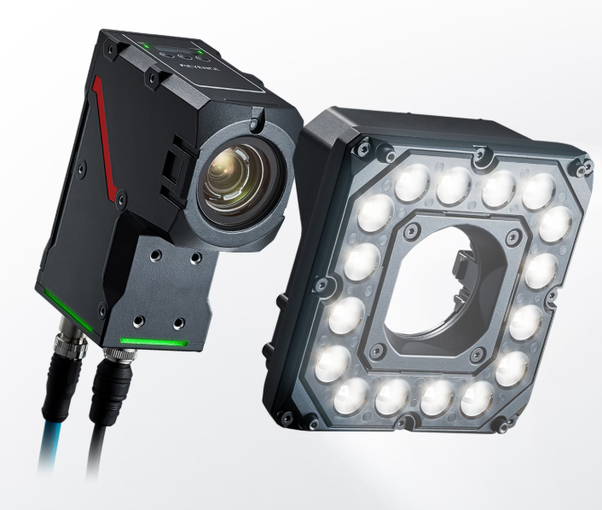
Robot & vision system
6 axis robot with reach of 912 mm. Very fast. Very accurate.
AI based vision system. Very fast processing. High repeatability.

Slide 10
THANK YOU
Mr.Swapnil Kapse​
kapse.s.s@gmail.com

